Slide 1
HIVE
By
Prof. Prakash Patel
Asst.Prof.-it dept.
git

Slide 2
What is HIVE?
Hive is a data warehouse infrastructure tool to process structured data in Hadoop.
It resides on top of Hadoop to summarize Big Data, and makes querying and analyzing easy.
Initially It was developed by Facebook, later the Apache Software Foundation took it up and developed it further as an open source.
It is used by different companies. For example, Amazon uses it in Amazon Elastic MapReduce.

Slide 3
Features of HIVE
It stores schema in a database and processed data into HDFS.
It is designed for OLAP.
It provides SQL type language for querying called HiveQL or HQL.
It is familiar, fast, scalable, and extensible.

Slide 4
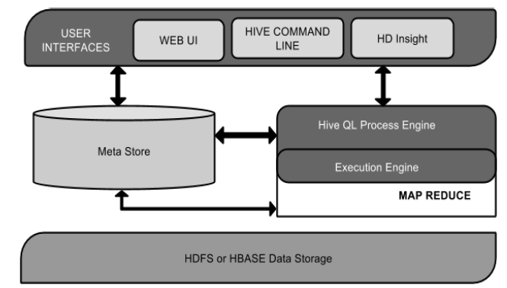
Architecture of Hive
The following component diagram depicts the architecture of Hive:

Slide 5
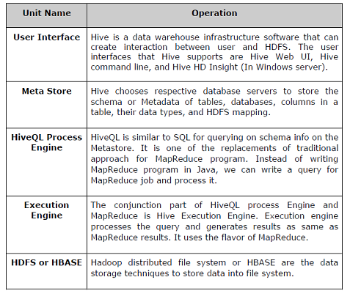
Components of HIVE

Slide 6
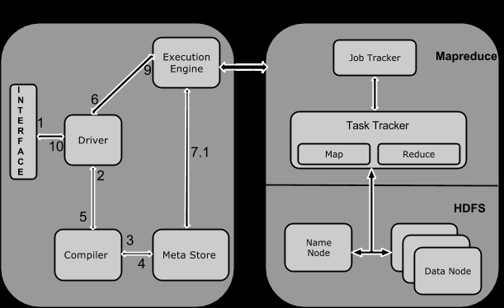
Working of Hive
The following diagram depicts the workflow between Hive and Hadoop.

Slide 7
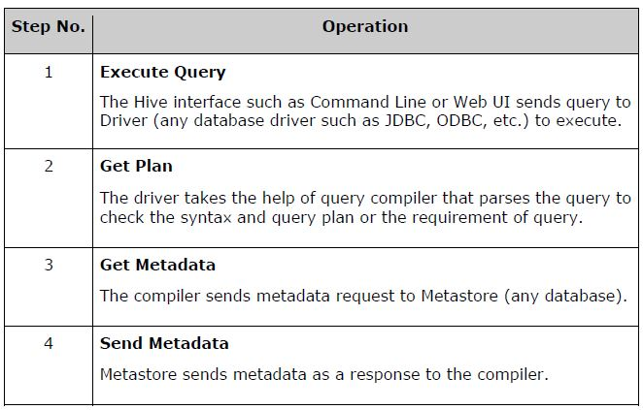
The following table defines how Hive interacts with Hadoop framework:

Slide 8
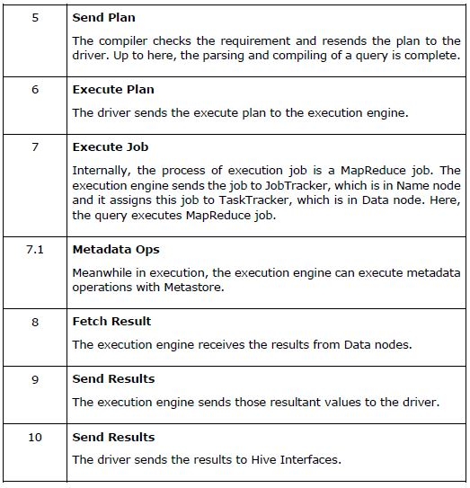
continue

Slide 9
HIVE Data Types
All the data types in Hive are classified into four types, given as follows:
1. Column Types
2. Literals
3. Null Values
4. Complex Types

Slide 10
Column Types
Integral Types
Integer type data can be specified using integral data types, INT. When the data range exceeds the range of INT, you need to use BIGINT and if the data range is smaller than the INT, you use SMALLINT. TINYINT is smaller than SMALLINT.
String Types
String type data types can be specified using single quotes (' ') or double quotes (" "). It contains two data types: VARCHAR and CHAR. Hive follows C-types escape characters.

Slide 11
Data types
Timestamp
It supports traditional UNIX timestamp with optional nanosecond precision. It supports java.sql.Timestamp format “YYYY-MM-DD HH:MM:SS.fffffffff” and format “yyyy-mm-dd hh:mm:ss.ffffffffff”.
Dates
DATE values are described in year/month/day format in the form {{YYYY-MM-DD}}.
Decimals
The DECIMAL type in Hive is as same as Big Decimal format of Java. It is used for representing immutable arbitrary precision.
Union Types
Union is a collection of heterogeneous data types. You can create an instance using create union.

Slide 12
Literals
Floating Point Types
Floating point types are nothing but numbers with decimal points. Generally, this type of data is composed of DOUBLE data type.
Decimal Type
Decimal type data is nothing but floating point value with higher range than DOUBLE data type. The range of decimal type is approximately
-10⁻³⁰⁸ to 10³⁰⁸.

Slide 13
Null Value
Missing values are represented by the special value NULL.

Slide 14
Complex Types
Arrays
Arrays in Hive are used the same way they are used in Java.
Syntax: ARRAY<data_type>
Maps
Maps in Hive are similar to Java Maps.
Syntax: MAP<primitive_type, data_type>
Structs
Structs in Hive is similar to using complex data with comment.
Syntax: STRUCT<col_name : data_type [COMMENT col_comment], ...>

Slide 15
Create Database
Create Database Statement:
Create Database is a statement used to create a database in Hive.
A database in Hive is a namespace or a collection of tables.
The syntax for this statement is as follows:
CREATE DATABASE|SCHEMA [IF NOT EXISTS] <database name>;

Slide 16
continue
The following query is executed to create a database named userdb:
hive> CREATE DATABASE [IF NOT EXISTS] userdb;
or
hive> CREATE SCHEMA userdb;
The following query is used to verify a databases list:
hive> SHOW DATABASES;
default
userdb

Slide 17
Drop Database
Drop Database is a statement that drops all the tables and deletes the database. Its syntax is as follows:
DROP DATABASE Statement
DROP (DATABASE|SCHEMA) [IF EXISTS] database_name [RESTRICT|CASCADE];
The following queries are used to drop a database. Let us assume that the database name is userdb.
hive> DROP DATABASE IF EXISTS userdb;

Slide 18
The following query drops the database using CASCADE. It means dropping respective tables before dropping the database.
hive> DROP DATABASE IF EXISTS userdb CASCADE;
The following query drops the database using SCHEMA.
hive> DROP SCHEMA userdb;

Slide 19
Create Table Statement
Syntax
CREATE [TEMPORARY] [EXTERNAL] TABLE [IF NOT EXISTS] [db_name.] table_name
[(col_name data_type [COMMENT col_comment], ...)]
[COMMENT table_comment]
[ROW FORMAT row_format]
[STORED AS file_format]

Slide 20
hive> CREATE TABLE IF NOT EXISTS employee ( eid int, name String,
> salary String, destination String)
> COMMENT ‘Employee details’
> ROW FORMAT DELIMITED
> FIELDS TERMINATED BY ‘\t’
> LINES TERMINATED BY ‘\n’
> STORED AS TEXTFILE;

Slide 21
Load Data Statement
There are two ways to load data: one is from local file system and second is from Hadoop file system.
Syntax
The syntax for load data is as follows:
LOAD DATA [LOCAL] INPATH 'filepath' [OVERWRITE] INTO TABLE tablename [PARTITION (partcol1=val1, partcol2=val2 ...)]
LOCAL is identifier to specify the local path. It is optional.
OVERWRITE is optional to overwrite the data in the table.
PARTITION is optional.

Slide 22
The following query loads the given text into the table from sample.txt file.
hive> LOAD DATA LOCAL INPATH '/home/user/sample.txt'
> OVERWRITE INTO TABLE employee;

Slide 23
Alter Table Statement
Syntax :
ALTER TABLE name RENAME TO new_name
ALTER TABLE name ADD COLUMNS (col_spec[, col_spec ...])
ALTER TABLE name DROP [COLUMN] column_name
ALTER TABLE name CHANGE column_name new_name new_type
ALTER TABLE name REPLACE COLUMNS (col_spec[, col_spec ...])

Slide 24
The following query renames the table from employee to emp.
hive> ALTER TABLE employee RENAME TO emp;
The following query adds a column named dept to the employee table.
hive> ALTER TABLE employee ADD COLUMNS ( > dept STRING COMMENT 'Department name');

Slide 25
The following query deletes all the columns from the employee table and replaces it with emp and name columns:
hive> ALTER TABLE employee REPLACE COLUMNS ( > eid INT empid Int, > ename STRING name String);

Slide 26
Drop Table Statement
The syntax is as follows:
DROP TABLE [IF EXISTS] table_name;
The following query drops a table named employee:
hive> DROP TABLE IF EXISTS employee;

Slide 27
VIEWS AND INDEXES
Creating a View
You can create a view at the time of executing a SELECT statement. The syntax is as follows:
CREATE VIEW [IF NOT EXISTS] view_name [(column_name [COMMENT column_comment], ...) ]
[COMMENT table_comment]
AS SELECT ...

Slide 28
The following query retrieves the employee details using the above scenario:
hive> CREATE VIEW emp_30000 AS
> SELECT * FROM employee
> WHERE salary>30000;

Slide 29
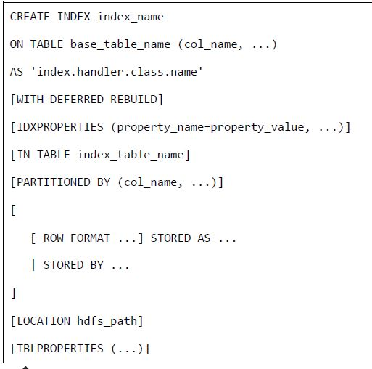
Creating an Index

Slide 30
hive> CREATE INDEX inedx_salary ON TABLE employee(salary)
> AS 'org.apache.hadoop.hive.ql.index.compact.CompactIndexHandler';

Slide 31
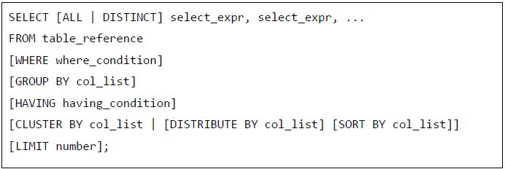
HIVEQL SELECT…WHERE
The Hive Query Language (HiveQL) is a query language for Hive to process and analyze structured data in a Metastore.

Slide 32
hive> SELECT * FROM employee WHERE salary>30000;

Slide 33
HIVEQL JOINS
JOINS is a clause that is used for combining specific fields from two tables by using values common to each one.
It is used to combine records from two or more tables in the database.
It is more or less similar to SQL JOINS.
There are different types of joins given as follows:
JOIN
LEFT OUTER JOIN
RIGHT OUTER JOIN
FULL OUTER JOIN

Slide 34
Syntax
The following query executes JOIN on the CUSTOMER and ORDER tables, and retrieves the records:
hive> SELECT c.ID, c.NAME, c.AGE, o.AMOUNT > FROM CUSTOMERS c JOIN ORDERS o > ON (c.ID = o.CUSTOMER_ID);

Slide 35
Outer Join
Left Outer
hive> SELECT c.ID, c.NAME, o.AMOUNT, o.DATE > FROM CUSTOMERS c > LEFT OUTER JOIN ORDERS o > ON (c.ID = o.CUSTOMER_ID);
Right Outer
hive> SELECT c.ID, c.NAME, o.AMOUNT, o.DATE > FROM CUSTOMERS c > RIGHT OUTER JOIN ORDERS o > ON (c.ID = o.CUSTOMER_ID);

Slide 36
Full outer:
hive> SELECT c.ID, c.NAME, o.AMOUNT, o.DATE > FROM CUSTOMERS c > FULL OUTER JOIN ORDERS o > ON (c.ID = o.CUSTOMER_ID);

